Slide 1
Unit-1 Introduction to E-Government and E-Governance

Slide 2
What is E-Government?
E-government can be defined as the use of ICTs to more effectively and efficiently deliver government services to citizens and businesses.
The underlying principle of e-government, supported by an effective e-governance institutional framework, is to improve the internal workings of the public sector by reducing financial costs and transaction times so as to better integrate work flows and processes and enable effective resource utilization across the various public sector agencies aiming for sustainable solutions.

Slide 3
Advantages of E-Government
It ensures greater level of efficiency and effectiveness in government activities and operations.
Improves access of information to the common mass.
It ensures the transparency in the operation of government programs.
It increases the reach of the government to the general public
It helps in improving the quality of public services
Increases communication between various government agencies.

Slide 4
What is E-Governance?
E-government is also known as e-gov, electronic government, Internet governance, digital government, online government, connected government
E-Governance is more about Governance than about “E”
E – Government: (short for electronic government) is the use of technological communications devices, such as computers and the Internet to provide public services to citizens and other persons in a country or region.
The term e‐Governance implies technology driven governance.

Slide 5
E-Governance
E-Governance is the application of Information and Communication Technology (ICT) for delivering government services, exchange of information communication transactions, integration of various stand‐alone systems and services between Government‐to‐Citizens(G2C), Government‐to-Business(G2B), Government‐to‐Government(G2G) as well as back office processes and interactions within the entire government frame work.
It also involves collaborating with business partners of the government by conducting electronic transactions with them. Besides, it entails enabling the general public to interact with the government, through electronic means, for getting the desired services.
In other words, e-governance means application of electronic means in the interaction between
1. Government (G) and citizens (C), both ways (i.e. G2C and C2G)
2. Government or businesses (B), both ways (i.e. G2B and B2G)
3. Internal government operation (G2G)
Notes:
Gto B – oil corporation

Slide 6
E-Governance
It establishes
a relationship between government officials and citizens, providing greater access to government information and services by making the government accessible online
promoting citizen participation by enabling citizens to interact more conveniently with government officials, such as by requesting government service and filing required documents through website
increasing government accountability by making its operations more transparent, thereby reducing the opportunities for corruption
supporting development goals by providing business, rural and traditionally underserved communities with information, opportunities and communications capabilities.
The aim, ultimately is to simplify and improve governance and enable people's participation in governance through mail, and Internet.
E-governance is much more than just preparing some websites.
It ranges from the use of Internet for the deliver of plain web based information at its simplest level to services and online transactions on the one hand and utilizing IT in the democratic process itself, i.e. election on the other.

Slide 7
E‐Government
E‐government is not only used in developed countries.
Some of the most innovative uses of the Internet in governance are being successfully used in the developing countries, as well.

Slide 8
Non‐Internet e‐Government
While e‐government is often thought of as online government or Internet-based government, many non‐Internet “electronic government“ technologies can be used in this context.
Some non-Internet forms include telephone, fax, PDA, SMS text messaging, MMS, wireless networks and services, Bluetooth, CCTV, tracking systems, RFID, biometric identification, road traffic management and regulatory enforcement, identity cards, smart cards and other Near Field Communication applications; polling station technology (where non‐online e-voting is being considered), TV and radio‐based delivery of government services, online community facilities, news groups and electronic mailing lists, online chat, and instant messaging technologies.

Slide 9
Difference between e-governance and e‐government
Both the terms are treated to be the same, however, there is some difference between the two.
e-Governance is a broader topic that deals with the whole spectrum of the relationship and networks within government regarding the usage and application of ICT Whereas e-Government is a narrower discipline dealing with the development of online government services to the citizen and businesses such as e-tax, e transportation, e-procurement, e-participation amongst others.
E-government is the use of the ICTs in public administrations combined with organizational change and new skills to improve public services and democratic processes and to strengthen support to public.
As a matter of fact, the governance of ICTs requires most probably a substantial increase in regulation and policy-making capabilities, with all the expertise and opinion-shaping processes among the various social stakeholders of these concerns.
So, the perspective of the e-governance is "the use of the technologies that both help governing and have to be governed".

Slide 10
Difference between e-governance and e‐government
E-Governance is the future: many countries are looking forward to for a corruption free government.
E‐government is one‐way communication protocol whereas E‐governance is two‐way communication protocol.
The essence of E-governance is to reach the beneficiary and ensure that the services intended to reach the desired individual has been met with.
There should be an auto-response system to support the essence of E-governance, whereby the Government realizes the effectiveness of its governance.
E-governance is by the governed, for the governed and of the governed.
Best form of E‐governance cuts down on unwanted interference of too many layers while delivering governmental services.
It depends on good infrastructural setup with the support of local processes and parameters for governments to reach their citizens or end beneficiaries.

Slide 11
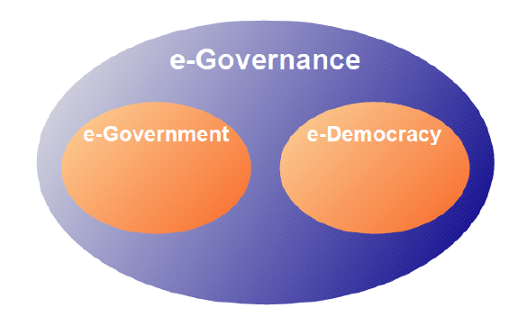
Difference between e­-governance and e‐government
Budget for planning, development and growth can be derived from well laid out E‐governance systems.
Notes:
Free and equal access

Slide 12
Difference between e-governance and e‐government
BASIS FOR COMPARISON | E-GOVERNMENT | E-GOVERNANCE
Meaning | The application of ICT, with the aim of supporting government operations, aware citizens and deliver services is called as e-Government. | e-Governance refers to the use of ICT in enhancing the range and quality of information and services delivered to the public, in an effective manner.
Behavior | It is like the institution or the apparatus to perform the job | It is the manner or the process to guide a society to best achieve its goals and interests
What is it? | System | Functionality
Communication Protocol | One way communication protocol | Two way communication protocol
Discipline | e-Government is actually a narrower discipline | e-Governance is a broader topic

Slide 13
WHY e‐GOVERNANCE?
To build an informed society
An informed society is an empowered society.
Only informed people can make a Government responsible.
So providing access to all to every piece of information of the Government and of public importance is one of the basic objectives of E‐Governance.
To increase Government and Citizen interaction
In the physical world, the Government and Citizens hardly interact.
The amount of feedback from and to the citizens is very negligible.
E-Governance aims at build a feedback framework, to get feedback from the people and to make the Government aware of people's problems.
To encourage citizen participation
True democracy requires participation of each individual citizen.
E‐governance aims to restore democracy to its true meaning by improving citizen participation in the Governing process, by improving the feedback, access to information and overall participation of the citizens in the decision-making.

Slide 14
WHY e‐GOVERNANCE?
To bring transparency in the governing process
E-governance carries an objective to make the Governing process transparent by making all the Government data and information available to the people for access.
It is to make people know the decisions, and policies of the Government.
To make the Government accountable
Government is responsible and answerable for every act decision taken by it.
E-Governance aims will help make the Government more accountable than now by bringing transparency's and making the citizens more informed.
To reduce the cost of Governance
E-Governance also aims to reduce cost of governance by cutting down on expenditure on physical delivery of information and services.
It aims to do this by cutting down on stationary, which amounts to the most of the government's expenditure.
It also does away with the physical communication thereby reducing the time required for communication while reducing cost.

Slide 15
WHY e‐GOVERNANCE?
To reduce the reaction time of the Government
Normally due to red tapism and other reasons, the Government takes long to reply to people's queries and problems.
E-Governance aims to reduce the reaction time of the Government to the people's queries and problems, because problems are basically Government's problems as Government is for the people.

Slide 16
WHY e‐GOVERNANCE?
E‐Governance provides SMARRT Government. The Acronym SMARRT refers to Simple, Moral, Accountable, Responsive, Responsible and Transparent Government. S-The use of ICT brings simplicity in governance through electronic documentation, online submission, online service delivery, etc. M-It brings Morality to governance as immoralities like bribing, red-tapism, etc. are eliminated. A‐It makes the Government accountable, as all the data and information of Government is available online for consideration of every citizen, the NGOs and the media. R ‐Due to reduced paperwork and increased communication speeds and decreased communication time, the Government agencies become responsive. R‐Technology can help convert an irresponsible Government Responsible. Increased access to information makes more informed citizens. The powered citizens make a responsible Government. T‐With increased morality, online availability of information and reduced red-tapism the process of governance becomes transparent leaving no room for the Government to conceal any information from the citizens.
Notes:
Red tapism …file lukaune … file yeta uti ghumaune

Slide 17
Need for E-Governance
The fundamental motivation for the campaign of e-governance is a slogan to provide SMART government "SMART" being an acronym for Simple, Moral, Accountable, Responsive and Transparent Government, a laudable ideal, though difficult it may be to achieve in reality.
Thus, we may conceive a Smart Village or Smart Municipality or Smart State, all very difficult but ideal models.
Notwithstanding the difficulties involved in achieving this, a clear objective of e-governance can be cutting the cost of e-governance and also minimizing the complexities of the procedures by possible business process reengineering.
The related benefit is empowerment of people through what is called 'disintermediation'; in other words, eliminating the middleman or tout between the government and the people.
For example, by doing so, property tax assessment and collection system can reduce the element of corruption in the system apart from increasing consumer convenience.

Slide 18
Need for E-Governance
The online system based on the Internet will reduce contacting with the mediating officials, thereby reducing the possibility of malpractice.
This does not however mean that the primary objective of e-governance is tackling with corruption
Evidently, the objectives of achieving such e-governance go far beyond mere simple computerization of stand-alone back office operations in government offices.
It should mean a drastic change in the way the government operates, and this means a new and redefined set of responsibilities for the executive, legislative and the judiciary.
This requires bringing about a social catharsis, which needs to be done in a comprehensive, concerted and planned manner.

Slide 19
Needs of E-governance
The strategic objective of e-governance is to support and simplify governance for all parties government, citizens, businesses and its employees. The use of ICTs can connect all three parties and support processes and activities.
There may be three major objectives of e-governance:
Service to the Public:
This objective of e-government is to satisfactorily fulfill the public’s needs and expectations on the front-office side, by simplifying their interaction with various online services.
The use of ICTs in government operations facilitates speedy, transparent, accountable, efficient and effective interaction with the public, citizens, business and other agencies.
Efficient Government:
In the back-office, the objective of e-government in government operations is to facilitate a speedy, transparent, accountable, efficient and effective process for performing government administration activities.
Significant cost savings (per transaction) in government operations can be the result.

Slide 20
Needs of E-governance
Good Governance:
As e-governance is transparent, there is less chance of corruption at all level.
It provides the service to the people in very easy manner and with less cost which makes the governance good governance.

Slide 21
Needs of E-governance
E‐Governance seek to achieve
Efficiency
Transparency
Citizen's participation
Enabling e‐governance through ICT contributes to
Good governance, Trust and Accountability
Citizen's awareness, empowerment and Citizen's welfare
Nation's economic growth
Ensure transparent, timely and hassle free delivery of services.
Provide greater public access to information and has proved to be a more efficient and cost‐effective way of governance.
E‐Government can transform citizen service, provide access to information to empower citizens, enable their participation in government and enhance citizen economic and social opportunities, so that they can make better lives, for themselves and for the next generation.

Slide 22
Advantages/Benefits of E‐Governance
Following are the advantages of E‐Governance:
Speed
Technology makes communication swifter.
Internet, Phones, Cell Phones have reduced the time taken in normal communication.
Cost Reduction
Most of the Government expenditure is appropriated towards the cost of stationary.
Paper‐based communication needs lots of stationary, printers, computers, etc. which calls for continuous heavy expenditure.
Internet and Phones makes communication cheaper saving valuable money for the Government.

Slide 23
Advantages/Benefits of E‐Governance
Transparency
Use of ICT makes governing process transparent.
All the information of the Government would be made available on the Internet.
The citizens can see the information whenever they want.
Current governing process leaves many ways to censor the information from all the people.
ICT helps make the information available online eliminating all the possibilities of censoring of information.
Accountability
Once the governing process is made transparent the Government is automatically made accountable.
Accountability is answerability of the Government to the people. It is the answerability for the deeds of the Government.
An accountable Government is a responsible Government.

Slide 24
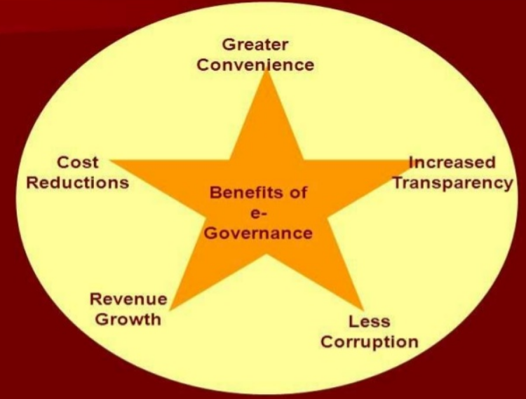
Advantages/Benefits of E‐Governance

Slide 25
E-Government as Information System
To understand e-government, we must understand IT.
IT handles data to produce information.
The next step to understanding e-government is to understand : e-government systems are information systems.
At their heart lie data and information.
These are handled by digital (and sometimes non-digital) information technologies.
To understand e-government as an information system, we must add in some notion of activity and purpose, that can only come if we bring people into the equation.
For e-government to be a working information system, it must be seen to consist of technology plus information plus people who give the system purpose and meaning plus work processes that are undertaken.
Therefore an initial model of an e-government system can be produced, as illustrated in Figure below

Slide 26
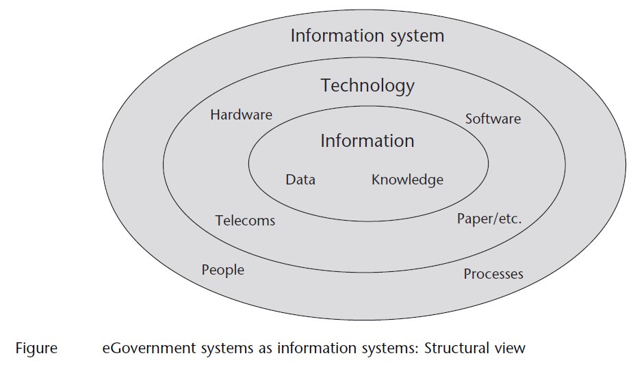
E-Government as Information System
Notes:
(Avison and
Fitzgerald, 2003).

Slide 27
IT Vs Information System
Payroll System
INFORMATION TECHNOLOGY
Hardware
Software
Databases
Networks
Other related components
Inventory System
are used to build
INFORMATION SYSTEMS
Marketing System
Customer Service System

Slide 28
E-Government as Information System
E-government systems can be described as ‘socio-technical systems’ because they combine both the social i.e. people and technical.
This is a first indication that, when managing e-government, both social and technical issues will have to be dealt with.
The model in Figure shown in previous slide is a good start, but it is incomplete.
Most of e-Government systems are embedded within public sector organizations that provide, for example, the management systems and the organizational resources that support e-government
These organizations also provide things like the political and cultural milieu within which e-government operates.
Many e-government systems also reach out to other groups (citizens, businesses) ; a few involve other public agencies.

Slide 29
E-Government as Information System
All these groups and organizations are themselves embedded in institutional environments: a broader context of laws and values, economic systems and technological innovations that affects both the agencies/groups and the systems including e-government systems that serve them.

Slide 30
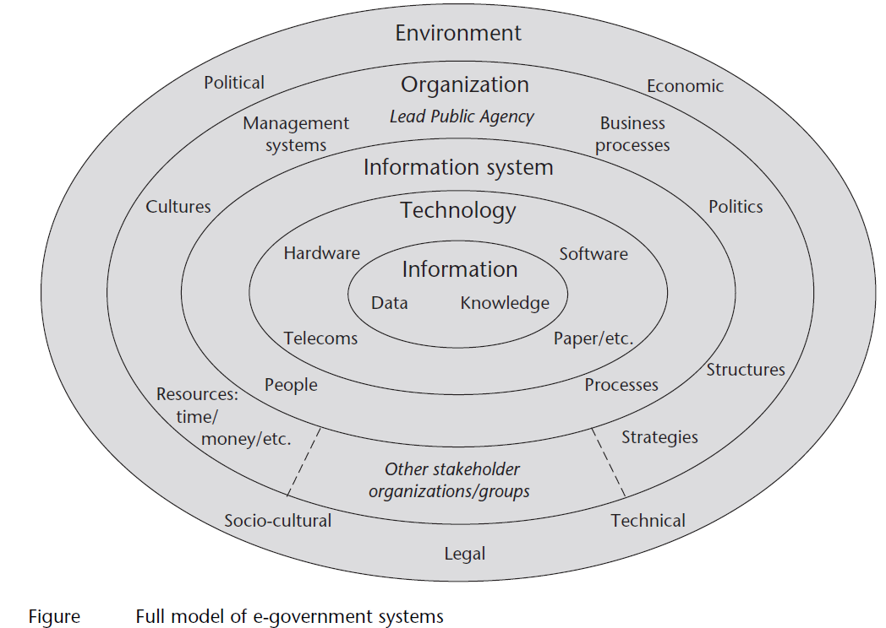
E-Government as Information System
Notes:
adapted from Heeks and Bhatnagar, 2001).

Slide 31
E-Government as Information System
Given that e-government systems are information systems, we can draw on one further model/checklist to help us understand e-government.
This understands an e-government application in terms of its information related tasks: a process view to go alongside the structural view offered above.
These tasks are summarized by the CIPSODA checklist, illustrated in Figure below.
The checklist of tasks can be explained in some further detail, using the example of part of an e-tax system:
Capture:
Gathering the raw data necessary for the e-government system.
The taxpayer obtains the basic data on their various sources of income.
Input:
Entering the data onto the system.
The taxpayer types the data into an e-form on the revenue agency’s web site.
Process:
Altering the data via calculation, classification, selection, and so on.
The e-tax system uses the different tax rates for different income types to calculate the total tax owed.
Notes:
• Capture: Gathering the raw data necessary
for the e-government system. The
taxpayer obtains the basic data on their
various sources of income.
• Input: Entering the data onto the system.
The taxpayer types the data into an
e-form on the revenue agency’s web site.
• Process: Altering the data via calculation,
classification, selection, and so on. The
e-tax system uses the different tax rates
for different income types to calculate
the total tax owed.
• Store: Holding raw and processed data
on the system. The e-tax system stores all
details entered and calculated about this
taxpayer.
• Output: Issuing the processed data. The
total tax calculated is displayed to the
taxpayer.
• Decision: If the processed data is useful
enough to be seen as information, it is
used for decision making. The taxpayer
determines whether to challenge or
accept the calculated tax sum.
• Action: Implementation of the decision.
If all is well, the taxpayer authorizes payment
of the tax owed.

Slide 32
E-Government as Information System
Store:
Holding raw and processed data on the system.
The e-tax system stores all details entered and calculated about this taxpayer.
Output:
Issuing the processed data.
The total tax calculated is displayed to the taxpayer
Decision:
If the processed data is useful enough to be seen as information, it is used for decision making.
The taxpayer determines whether to challenge or accept the calculated tax sum.
Action:
Implementation of the decision.
If all is well, the taxpayer authorizes payment of the tax owed.

Slide 33
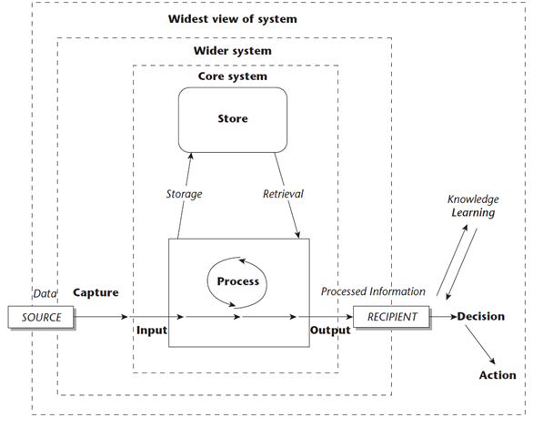
E-Government as Information System
Fig: E-Government system as Information system: Process view

Slide 34
E-Government Life Cycle
Innumerable methods for systems development have been created, with a variance here or there, but all of them correspond more or less to four core stages:
Analysis of what is currently happening, and of whether and why a new e-government system is needed
Design of the new e-government system’s components
Construction of the new e-government system
Implementation of the new e-government system.
Any e-government systems project seeks to create a new situation that is different from the current one.
The greater the difference between the new and current situations, the greater the degree of change that is required, and the greater the likelihood of system failure.
Successfully planned e-government systems will therefore be those that require a manageable degree of change.

Slide 35
E-Government Life Cycle
Integrating the ideas into the four core stages listed above, and then topping and tailing them with assessment and post-implementation activities, the outline of the method can be described as a set of five stages
Project assessment
Analysis of current reality
Design of the proposed new situation
System construction
Implementation and beyond
Overall the stages can be called a ‘systems development life cycle’ because the post-implementation stages may lead to the identification of a new e-government project, thus restarting the whole process again.
The lifecycle is shown in Figure

Slide 36
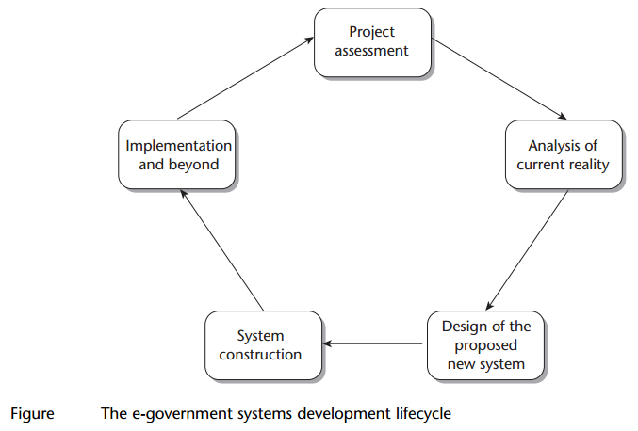
E-Government Life Cycle

Slide 37
E-Government Life Cycle
Project Assessment:
Identifying possible e-government projects
Outlining basic project parameters
Assessing whether or not to proceed with the project.
New e-government projects are typically initiated based on: “a problem that needs to be solved” or “identification of an opportunity which could be seized”
Analysis of current reality:
Description and analysis of the seven ITPOSMO dimensions as they exist within the current situation of the organization.
A SWOT-analysis
Notes:
The Design-Reality Gap Analysis framework
There are seven dimensions of the Model of Conception: information, technology, processes, objectives and values, staffing and skills, management and structures, other resources: time and money.
SWOT (strengths, weaknesses, opportunities, and threats)

Slide 38
E-Government Life Cycle
Design of the Proposed New Situation:
Setting objectives for the proposed new e-government system, and then describing in general terms how the seven ITPOSMO dimensions should be different for the new system to meet these objectives.
In this stage issues of software and hardware need to be dealt with.
Work processes are also necessary to take into account from a design perspective, and not just the front-end processes, but also the underlying processes
Different options for the new system may be evaluated at this point.
System Construction:
Consists of Process and activities in acquiring any new IT
Undertaking detailed design of the new e-Government system(For example system installation)
Then building it
Testing it
Documenting it.

Slide 39
E-Government Life Cycle
Implementation and beyond:
Represented by the planning of implementation processes
For example Training users to use the new system
Converting data from old to new formats
Introducing the new system
Monitoring and evaluating its performance and context
Then undertaking any necessary system maintenance.

Slide 40
e‐Governance Challenges
E-governance, however, is not really the use of IT in governance but as a tool to ensure good governance.
E-­governance does not mean proliferation of computers and accessories
it is basically a political decision which calls for discipline, attitudinal change in officers and employees, and massive government process re-engineering.
All implementers and drivers of e-governance initiatives agree that the biggest challenge of deploying e-governance is not technology but change management.
Change management is important not only in terms of cultural change but also in terms of changing operations and processes workflow that the automated environment will introduce.
"It's important to educate people at all levels about the benefits of technology. The various benefits and advantages of e-enabling the system should be communicated clearly right at the beginning to ensure popular support which will lead to greater chances of success."

Slide 41
e‐Governance Challenges
The key challenges with electronic governance are not technology or Internet issues but organizational issues like:
Redefining rules and procedures
Information transparency
Legal issues
Infrastructure, Skill and awareness
Access to right information
Interdepartmental collaboration
Tendency to resist the change in work culture
Other obstacles are geographical distances, lack of trained human resources and lack of ICT penetration in remote areas.
For instance, a good e-governance application will not benefit any body in remote areas if there is no supporting infrastructure such as electricity, computers and connectivity.
The challenges of connectivity have also reduced over the years with the falling prices of bandwidth and increased reach of connectivity service providers.

Slide 42
e‐Governance Challenges
Many governments have developed nation wide networks, customized applications, and data banks but the interconnectivity of the servers is an issue, which calls for the establishment of state datacenters.
The other set of challenges lie in extending the reach of e-Governance services to Nepalese population that lives in villages. These include:
Assessment of local needs and customizing e-Governance solutions to meet those needs
Connectivity
Content (Local content on Local language)
Building Human Capacities
e-Commerce
Sustainability

Slide 43
Evolution, Scope and Content of E‐governance
Initiatives were take up as early as 1972 by Chile
Prof. Stafford Beer implemented for President Allende of Chile, the first governance software that would help the government survive a severe crisis.
Major contribution by US Vice President Al Gore in early 1990s which rooted worldwide in the information superhighway(high speed network)
The Information Super Highway was defined largely in terms of the information infrastructure at the national level by many countries including US, UK, Canada, Australia and India
The focus was then largely on development of components of infrastructure such as fiber optic networks across the states or nations.
The interest was widened to include socio-economic considerations encapsulated in the concept of Information Society or Knowledge Society evolved

Slide 44
Evolution, Scope and Content of E‐governance
E‐governance came into a formalized and focused manner with partial success to implement Information System in the government departments and public organizations in various countries including India.
During 1980s and 90s, governments all over the world lagged behind the commercial world in accepting and implementing ICT.
Commercial and industrial world went far ahead all over the world in harnessing(make use of) the potential of ICT in their core and peripheral activities.
Commercial enterprises utilized ICT increasingly to reach out to their customers and business partners, thereby impressively enhancing their quality, speed and convenience.
E-commerce thus became a big boom (even though the boom never reached the expected levels)
Visible success cases of use of ICT include
24 hours ATM services
24 hour call center
E‐Shopping on web.
Integrating Cable TV with internet.
Examples cited for typical information system that run the back offices in the financial and other sectors of business and industry.
Back office computerization handled offshore in developing countries like India where skilled software manpower and also unskilled manpower became available at low cost.

Slide 45
Evolution, Scope and Content of E‐governance
The cost effective satellite communication infrastructure facilitated remote development and maintenance of software in banking, financial, aviation, industrial sector.
Software export increase (banking, financial, aviation, industrial sector from India, Ireland, Israel, China)
1990s and 2000 ‐ Development of ITES (IT enabled Society)
resulted in remote services like call centers, data entry
Government last in the queue of institutions providing IT services
Initial Efforts in E‐governance:
‐ Partial automation of existing paper based manual process
‐ Did not result in significant Business Reengineering Process compared to private sector
No big changes seen in government enterprises may be because of
‐ Conservatism
‐ Resistance to change
‐ Rigidity of legislative body which impedes the amendment of rules and procedure

Slide 46
Evolution, Scope and Content of E‐governance
Major issues that has become highly relevant for large scale implementation of ICT in governance
‐ Issue of Security
‐ Privacy
‐ Vulnerability (exposure) of public ICT infrastructure to crime
‐ Potential to abuse, terrorism and general crime
‐ Problems in social cohesion (unity)
‐ Social Exclusion ‐ digital divide

Slide 47
Evolution, Scope and Content of E‐governance
The scope of ICT implementation in government machinery results
in
‐ Improvement of efficiency and effectiveness of the executive
function of government, including delivery of public services
‐ Greater transparency of government to citizens and business
permitting greater access to the information generated or collated
by the government
‐ Fundamental changes and improvement in relations between
citizen and the state thereby improving the democratic process
‐ Better interactions and relationships amongst different
Wings of the same government
State or local government within a country
Countries whose governance are web‐enabled

Slide 48
Evolution, Scope and Content of E‐governance
Any e‐governance activity/project involves appropriate
‐ Hardware and corresponding system software
‐ Networking of the hardware identified above‐ both the
Internet and Intranet environment
‐ Application software along with appropriate database
management software.

Slide 49
Present Global Trends of Growth In E‐Governance
According to press reports during the end of 2002
‐ Indicate a trend of global growth in e‐governance utilization
‐ Adults using internet world wide to access government services increase
by 15% according to the findings of Second Government Online Study
published by Taylor and Nelson.
‐ 3 out of 10 citizens (30%) access government services online
compared with only a quarter (26%) in 2001
Government online services are mostly used for
‐ Search Information (24% of user)
‐ Download Information (11% of user)
‐ Increase in % for searching information – 20% to 24% from Sep 2001 to
Sep 2002
Globally, online government transactions increased from just 6% to 7% during 2001 and 2002 and the percentage of those providing personal details to government increased from 7% to 8%

Slide 50
Present Global Trends of Growth In E‐Governance
E governance usage in different countries (between 2001‐2002)
Australia – significant increase from 31% to 46%
Turkey – 3% to 13%
Netherlands – 32% 41%
US – 34% to 43%
Japan – decrement by 4% from 17% to 13%
In 2001, security issue was the main concern which improved globally in 2002.
2001 – 14% felt secured with credit card and bank account numbers
2002 – this increased to 23%
Highest levels of safety was seen in the Scandinavian Market (Denmark, Finland, Norway and Sweden) together with some South East Asian markets (Singapore and Hong Kong)‐ around 1/3 of users felt safe.
In contrast, greatest safety concerns were expressed by citizens in japan‐ 90% of Japanese felt accessing online services unsafe.
Germany 82% and France 76% ‐ unsafe

Slide 51
Other Key Findings
Globally, Government online use is more prevalent among men (33%) than women (26%); and among those aged under 35 compared with other age groups.
2001 – 2002 ‐ Subsequent rise in government online usage among
35‐44 years old (22% to 36%)
55‐64 years old (2% to 18%)
65 years and above decreased ( from 7% in 2001 and 5% in 2002)
Globally, no. of internet users making government transaction online = users making online shopping transaction
15% of internet users have made online government transactions and in addition 15% have made an online purchase at least during that year.
Only 16% users in Hungary access government online services while its 81% in Norway

Slide 52
Other Key Findings
In countries like Singapore, Norway and Sweden – high usage of online government services as the citizens feel comfortable with this approach of dealing with the government
In Britain, New Zealand and South Korea – usage of government online services lags behind the general internet usage
All the above statistics on usage of e‐governance services is time bound.
Over the years, there has been a definite rise in the usage of e‐governance all over the world
Today, the number of websites is estimated at one billion.
According to statistics (Miniwatts Marketing Group, 2015) over 70 % of Europe´s population are active users of the Internet.
A higher percentage is in North America (87.7%) and Australia and Oceania (72.9%)

Slide 53
Online Service Delivery and Electronic Service Delivery
Electronic Service Delivery is process of providing government services through internet or any other electronic means.
It is related to e-services and e-government.
Electronic service, short as e-service, is a general term that refers to services over the information communication technologies.
The term e-service has many applications and can be found in many disciplines.
The two dominant application areas of e-services are E-business (or e-commerce) and E-government (or non-commerce)
E-business (or e-commerce): e-services mostly provided by businesses or (NGOs) (private sector).
E-government: e-services provided by government to citizens or business (public sector is the supply side)
Computer Language Company (2009) defines e-services as an umbrella term for services on the Internet.
E-services include e-commerce transaction services for handling online orders, application hosting by application service providers (ASPs) and any processing capability that is obtainable on the Web.

Slide 54
Online Service Delivery and Electronic Service Delivery
Chun Hai (2007) argues that eservices are services on the Internet where it is possible to make a purchase and sale transaction, unlike traditional websites, where only have descriptive information available and no online transaction is made possible.
Similar Zeithaml and Bitner (2003) defined e-service as web services delivered through the Internet.
Wilson (1998) mentioned that ‘an e-service is an activity or series of activities that takes place during the interaction between a provider and a customer through an electronic channel’
Methodical instructions (Finance Ministry of Slovak Republic, 2006) defines electronic services as "a service provided electronically by means of information and communication tools".
Under the Law (Ministry of Communication of Slovak Republic, 2006) are public online services defined as: electronic communication with obligated persons in dealing with the administration, notification, access to information and to the provision, or public participation in the administration of public affairs.
Similarly, e-services defined by the European judiciary, stating that e-service is a service or resource on the Internet, which was set up to improve communication between citizens and businesses on the one hand and the European Institutions on the other side (European Justice, 2015).

Slide 55
Online Service Delivery and Electronic Service Delivery
Electronically supplied services includes for example website supply, web-hosting; telecommunications services; goods, where the order and processing is done electronically etc.
The available definitions are built on one main idea the internet or other electronic network.
Various laws and experts define that e-services may vary, but all agree on the role of technology in transferring services. Therefore, eservices extend beyond the Internet.
The e-services "off-line" can include telephone, fax, personal digital assistant, text messages, picture messages, Bluetooth, tracking system, radio-frequency identifiers, biometrics identifiers, electronic ID cards, e-mail, chat, and many others (Wikipedia Foundation, 2015)
E-Service constitutes the online services available on the Internet, whereby a valid transaction of buying and selling (procurement) is possible, as opposed to the traditional websites, whereby only descriptive information are available, and no online transaction is made possible." (Jeong, 2007)

Slide 56
Online Service Delivery and Electronic Service Delivery
In other words, e-governance may be defined as the delivery of government services and information to the public by using electronic means.
These technologies enable the government to transform its relations with its other wings, citizens, businesses.
Such an exercise leads to better delivery of government services to citizens, improved interactions with business and industry, citizen empowerment through access to information and a more efficient government management.
The resulting benefits can be lesser corruption, increased transparency, greater convenience, revenue growth, and/or cost reductions

Slide 57
THANK YOU

